Slide 1

Work From Home and the Post-COVID U.S. Housing Market
Intro
Recap
Pivot
Analysis
Modeling
William Hymer, Andrea Padilla, Paige Park, and Mingduo Zhao

Slide 2

01
Initial Presentation Recap
Intro
Recap
Pivot
Analysis
Modeling

Slide 3

Initial Presentation Goals
Intro
Recap
Pivot
Analysis
Modeling
Describe differences in Work From Home prevalence by metropolitan/micropolitan statistical area
Determine which MSA characteristics contribute to prevalence

Slide 4

Data Sources and Merging
Intro
Recap
Pivot
Analysis
Modeling
American Community Survey (ACS)
Provides annual demographic, social, economic, and housing information
Public API available
Very little missing data, simple to clean
Missing a few variables of interest
No data from 2020
Our Process
Minor cleaning: setting NAs, variable names
Merged data across years by MSA ID
Created 3 data frames:
All variables for 2021 and WFH % from 2017-2019 for each MSA
Only WFH % for each MSA across 2017-2019 and 2021
All variables for all four years

Slide 5
Variable Overview
Intro
Recap
Pivot
Analysis
Modeling
Variables | Description
home_perc | Percent working from home in 2021
perc_diff | Percent change in average WFH percent from pre-COVID to 2021
log(working_pop) | Working population size
log(med_inc) | Median income
med_rent | Median rent
ag_perc | Percent working in agriculture industry
finance_perc | Percent working in financial industry
info_perc | Percent working in information industry
unemp_perc | Percent unemployed
Notes:
*log scale for population, income because we are interested in percentage changes rather than effect of a single dollar, single individual
*target variable perc_diff more interpretable

Slide 6
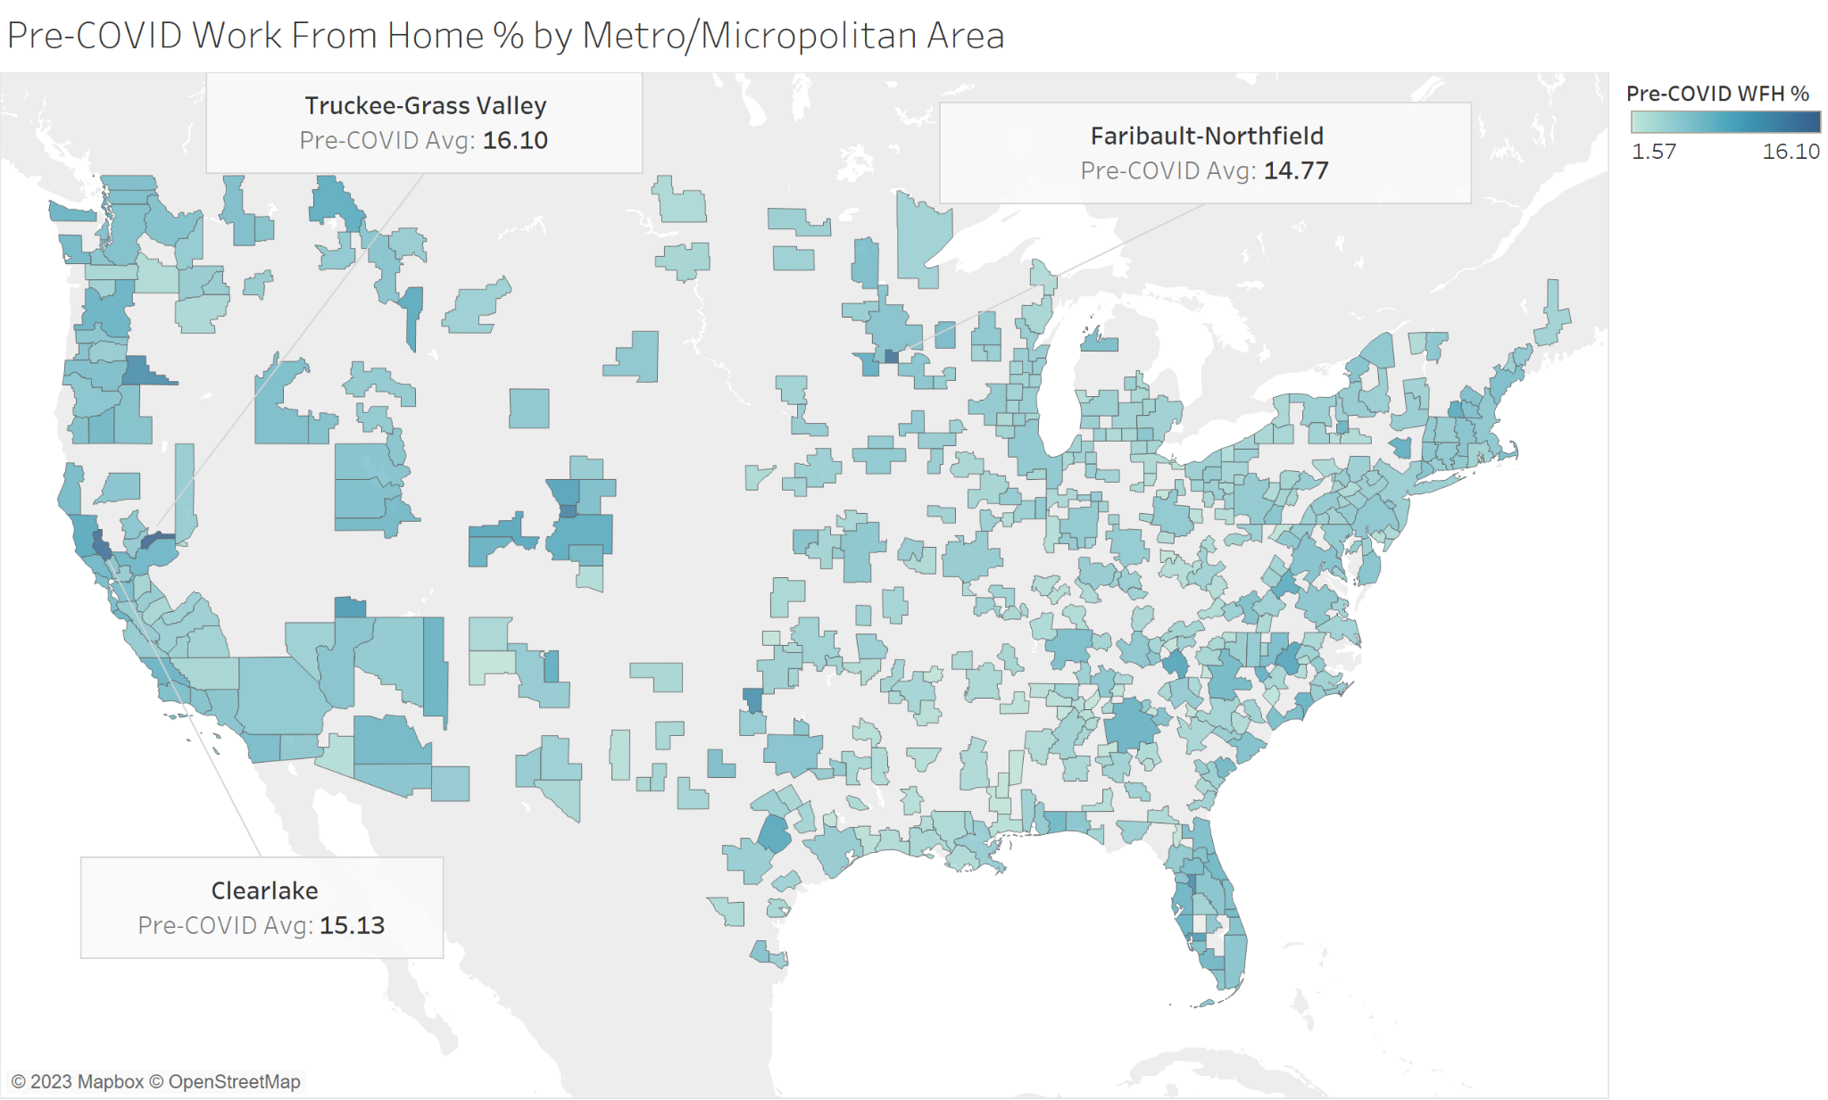
2017-2019 Average Work From Home %
Intro
Recap
Pivot
Analysis
Modeling
Highest WFH % outside of major cities
Maximum WFH% of around 16%
Average of 4.8% remote workers overall

Slide 7
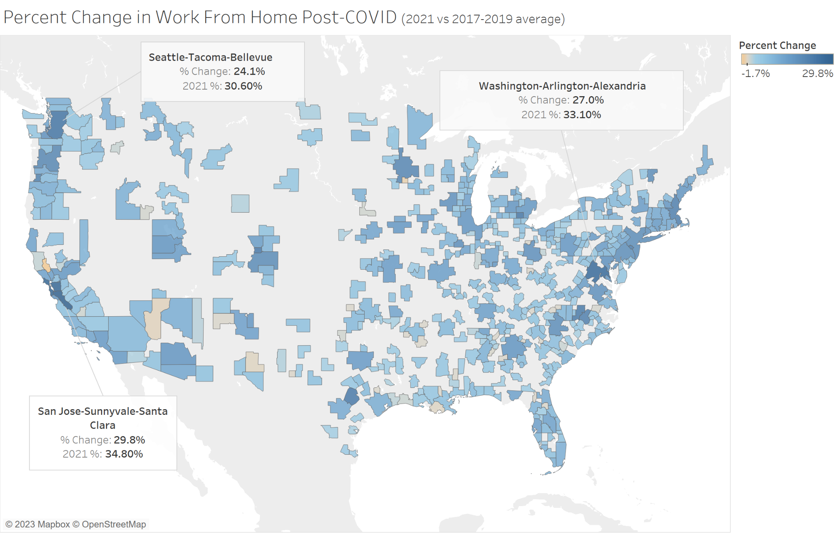
Post-COVID Work From Home Change
Intro
Recap
Pivot
Analysis
Modeling
Nearly all areas have increased WFH %
Largest WFH% now in large, high cost-of-living areas
Former WFH leaders see minimal change, if any
Average WFH increase of 6.9%

Slide 8
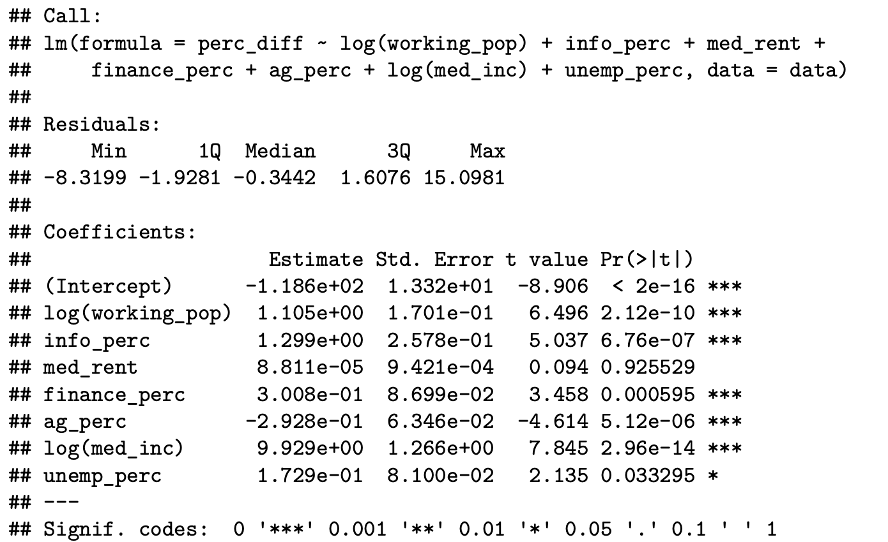
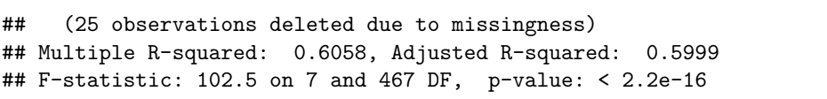
Initial Regression Results
Intro
Recap
Pivot
Analysis
Modeling
(“2021% - pretrend” as the outcome variable)
Concern: collinearity. Examples: Percentages; med_inc and med_rent.
To verify the findings, supplementary techniques such as machine learning may be necessary.

Slide 9

02
Pivot to Housing Insights
Intro
Recap
Pivot
Analysis
Modeling

Slide 10
Moving from Descriptive to Actionable
Intro
Recap
Pivot
Analysis
Modeling
WFH and Housing Costs
Machine learning results showed importance of rent variable
Prior work has also investigated WFH/real estate price relationship (Nieuwerburgh 2022)
Investigating relationship between WFH and housing costs could bring more concrete benefits to interested parties
Variables | Feature Importance
log(working_pop) | 14.203
med_rent | 14.013
finance_perc | 12.638
ag_perc | 12.103
med(log_inc) | 12.032
info_perc | 11.622
unemp_perc | 9.904

Slide 11
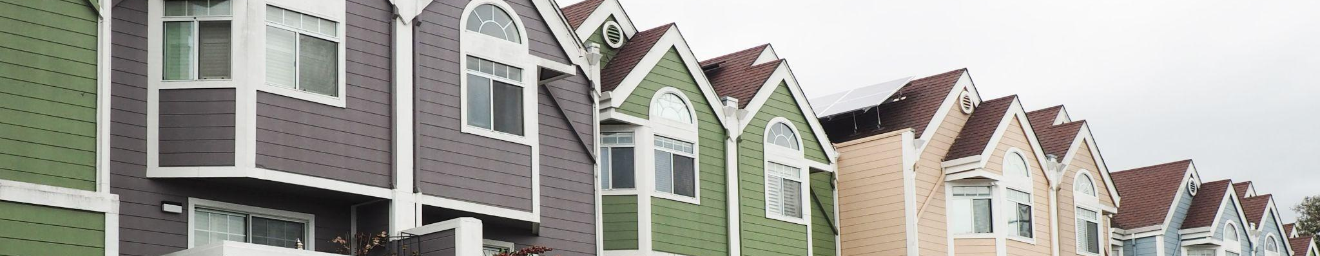
New Research Question
Intro
Recap
Pivot
Analysis
Modeling
What can Work From Home % tell us about the U.S. housing market?

Slide 12

Who May Be Interested in These Results?
Urban Planners
Policymakers
Intro
Recap
Pivot
Analysis
Modeling
Input to zoning decisions for urban development
Inform rent stabilization policies (rent ceilings)

Slide 13
Adding Housing Variables
Intro
Recap
Pivot
Analysis
Modeling
Variables | Description
household_size | Average size of all households
renter_householdsize | Average size of renter households
rentedhousing_perc | Percent of housing occupied by renters
mortgaged_housing | Estimate of housing that is mortgaged
mortgaged_SMOC | Median selected monthly owner costs (SMOC)
medhousing_value | Median value of housing
rent_lt15perc | Percent of renters who spend less than 15% of income on rent
rent_[x]to[y]perc | Percent of renters who pay between x-y% of income on rent, increments of 5
rent_gt35perc | Percent of renters who spend more than 35% of income on rent
med_rent | Median rent
Notes:
Use this slide as motivation for PCA: want to reduce these to one single number that can be used to describe housing prices in an MSA

Slide 14

03
Intro
Recap
Pivot
Analysis
Modeling
Analysis

Slide 15
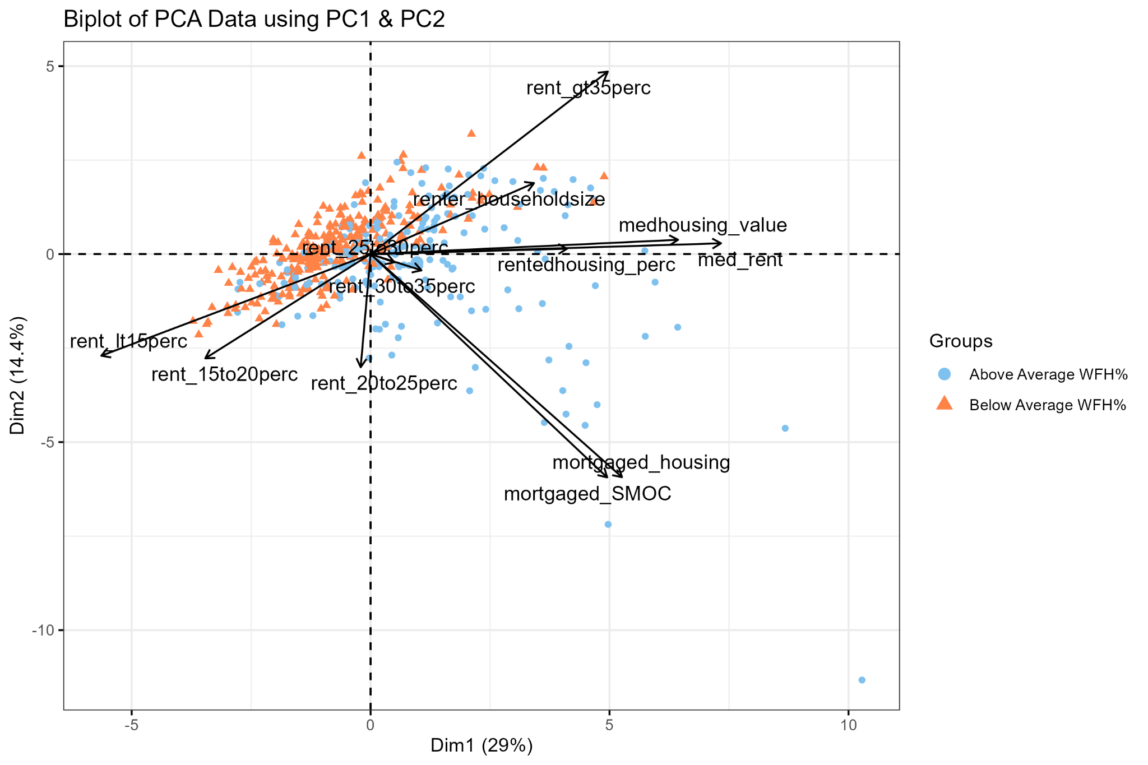
Principal Component Analysis
Intro
Recap
Pivot
Analysis
Modeling
Projecting the MSAs onto the first and second principal components gives us an information-dense look at the relationship between housing costs and work-from-home percentage
PC1 appears to be mostly related to rent costs and % of income spent on rent
PC2 is predominantly associated with financial expenses, albeit with considerable noise.
Jefferson City (MO)
Los Angeles-Long Beach-Anaheim
New York-Newark-Jersey City
Notes:
Biplot with labels

Slide 16
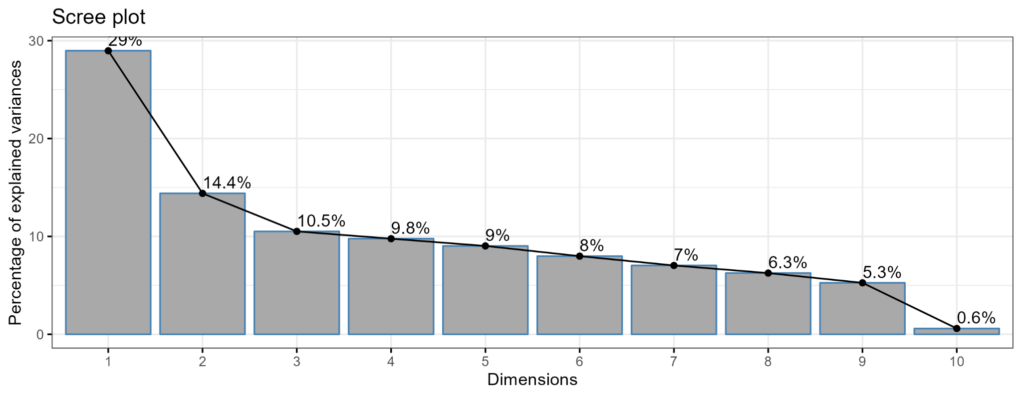
Principal Component Analysis
Intro
Recap
Pivot
Analysis
Modeling
| Variable | Comp.1 | Comp.2 |
|----------------------|--------|--------|
| rentedhousing_perc | 0.26 | 0.01 |
| renter_householdsize | 0.22 | 0.17 |
| mortgaged_housing | 0.34 | -0.54 |
| mortgaged_SMOC | 0.32 | -0.54 |
| rent_lt15perc | -0.36 | -0.24 |
| rent_15to20perc | -0.22 | -0.25 |
| rent_20to25perc | -0.01 | -0.27 |
| rent_25to30perc | 0.03 | -0.02 |
| rent_30to35perc | 0.07 | -0.04 |
| rent_gt35perc | 0.32 | 0.44 |
| medhousing_value | 0.41 | 0.03 |
| med_rent | 0.47 | 0.03 |
Principal Component 1
Driven primarily by median rent prices and proportion of population spending 1-15% or 35%+ of their income on rent
Principal Component 2
Driven primarily by financial expenses
Notes:
Biplot with labels

Slide 17
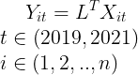
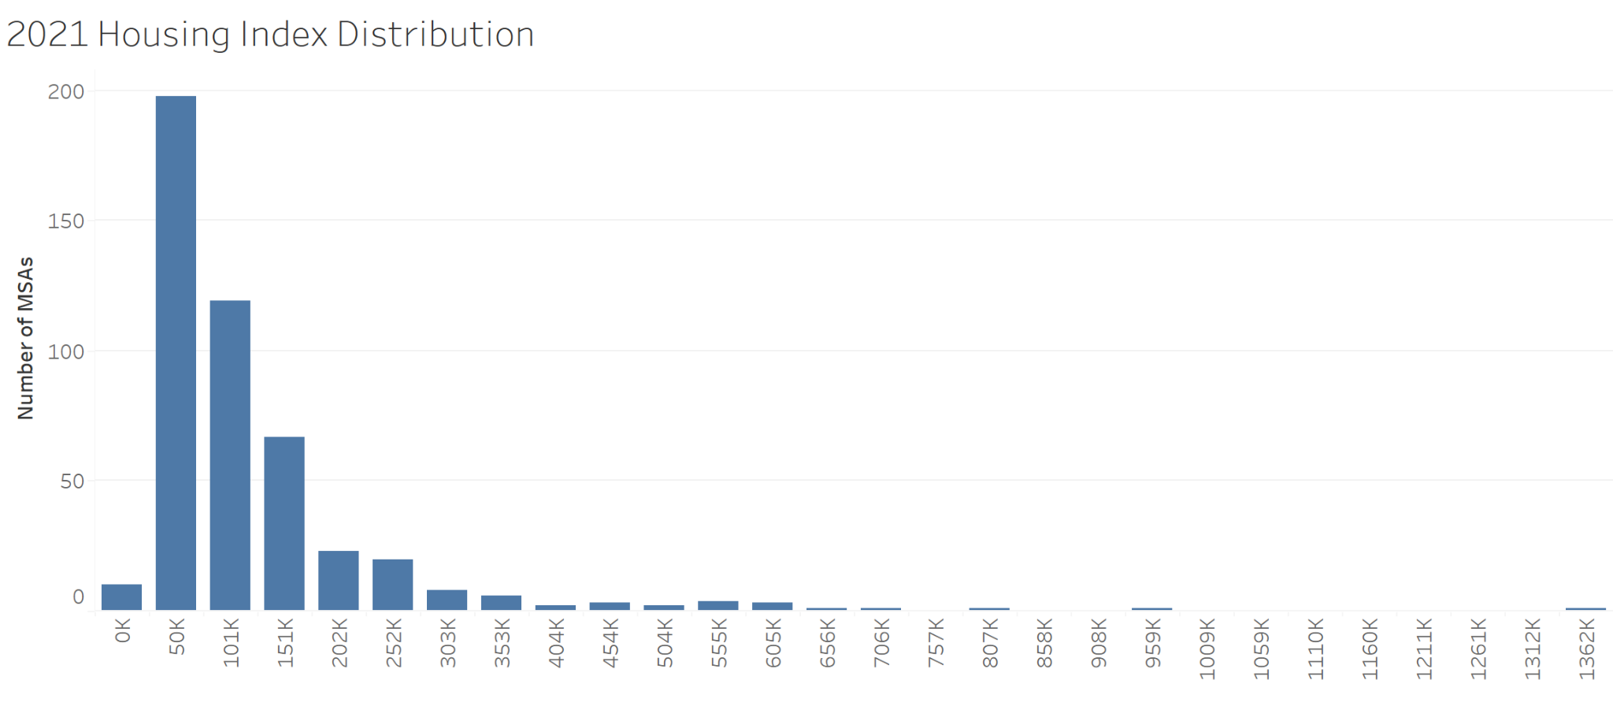
Housing Price Index
Intro
Recap
Pivot
Analysis
Modeling
The loadings of Principal Component 1 can be used to construct a housing price index:
Y_{it}: Housing index for MSA i in year t
X_{it}: Housing covariates for MSA i in year t
L: Loadings of Principal Component 1
Notes:
Formula or visual, throw in reference to existing literature. Betas are loadings, x are list of covariates List of coefficients

Slide 18
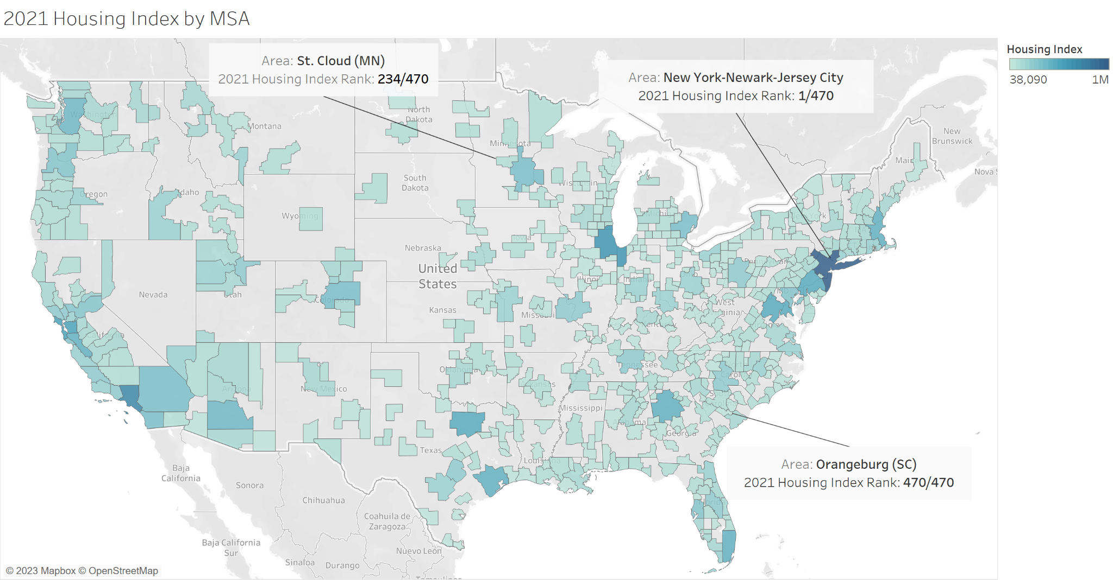
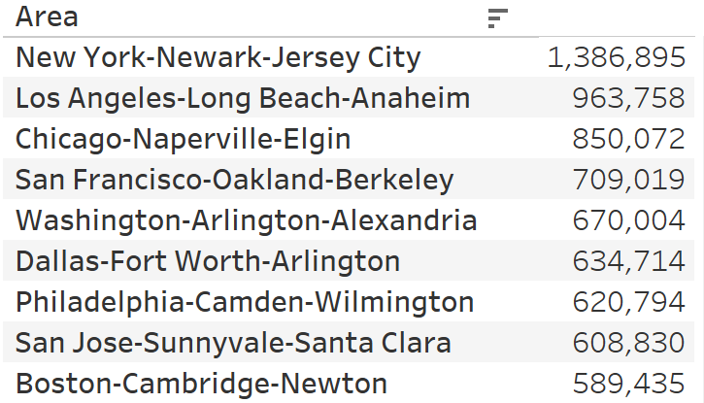
MSA Housing Price Index Validation and Overview
Intro
Recap
Pivot
Analysis
Modeling
Top MSAs by 2021 Index
The index shows promising and intuitive results as a metric for MSA housing prices
Notes:
Formula or visual, throw in reference to existing literature. Add top 10 MSA Betas are loadings, x are list of covariates List of coefficients

Slide 19
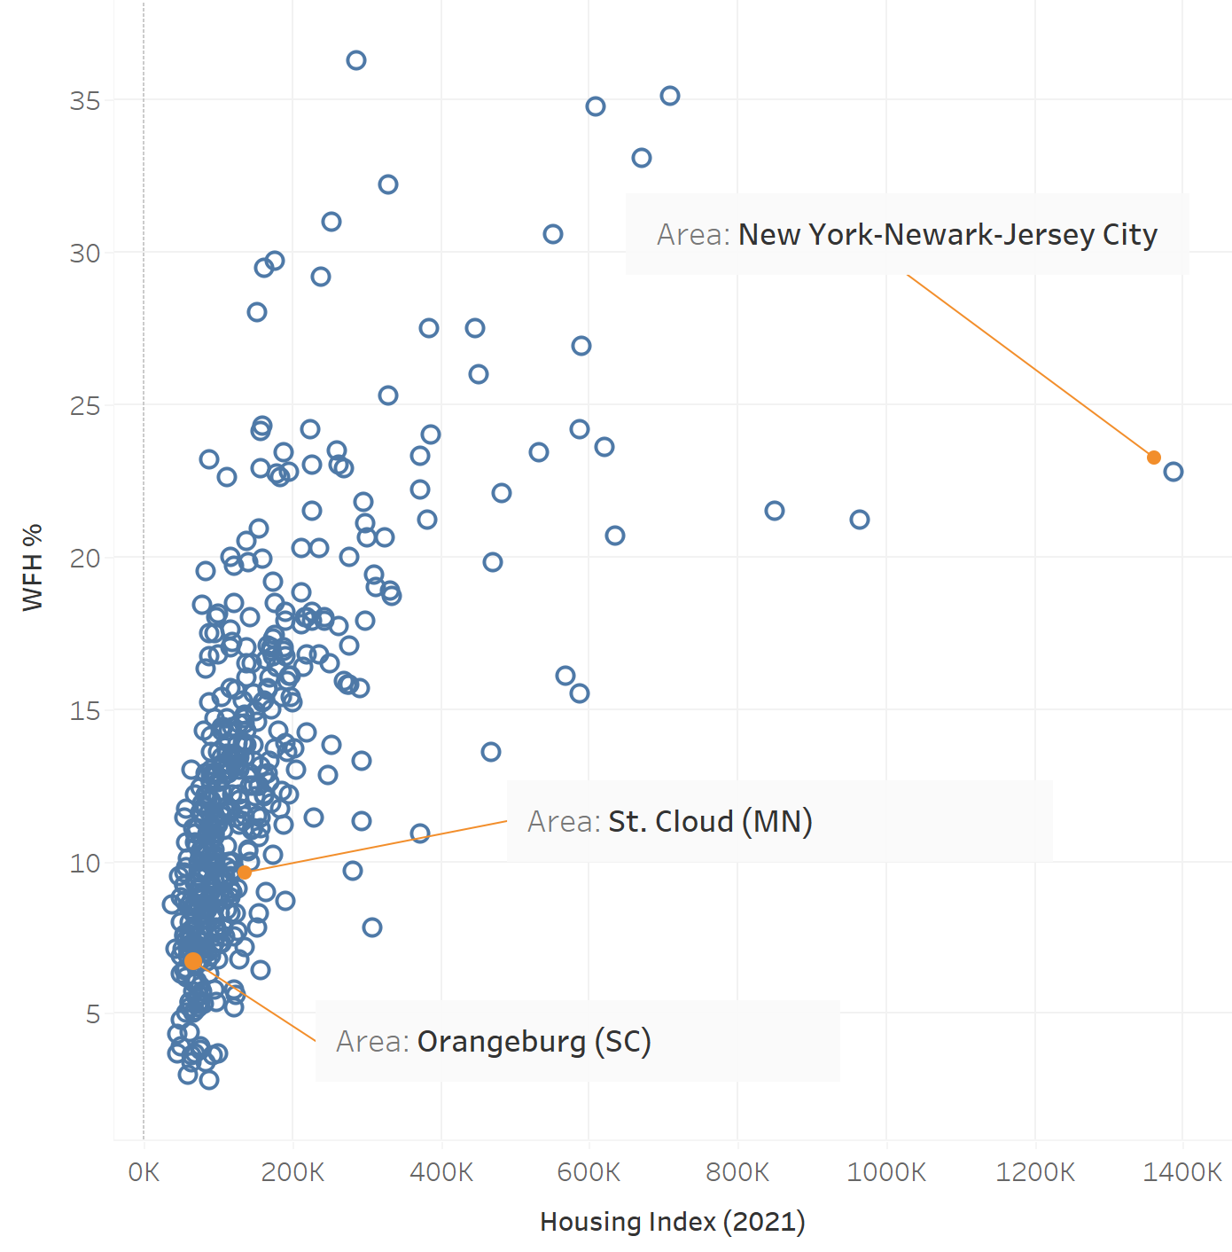
Housing Price Index vs Work-From-Home %
Intro
Recap
Pivot
Analysis
Modeling
We observe a positive (but potentially non-linear) association between MSA housing prices and WFH%.
Is it possible to predict housing prices using WFH% and non-housing covariates?
Notes:
Formula or visual, throw in reference to existing literature. Add top 10 MSA Betas are loadings, x are list of covariates List of coefficients

Slide 20

04
Modeling
Intro
Recap
Pivot
Analysis
Modeling

Slide 21


Regression Equation
Intro
Recap
Pivot
Analysis
Modeling
Outcome variables represents the housing index in 2021 or the change in housing index between 2019 and 2021.

Slide 22
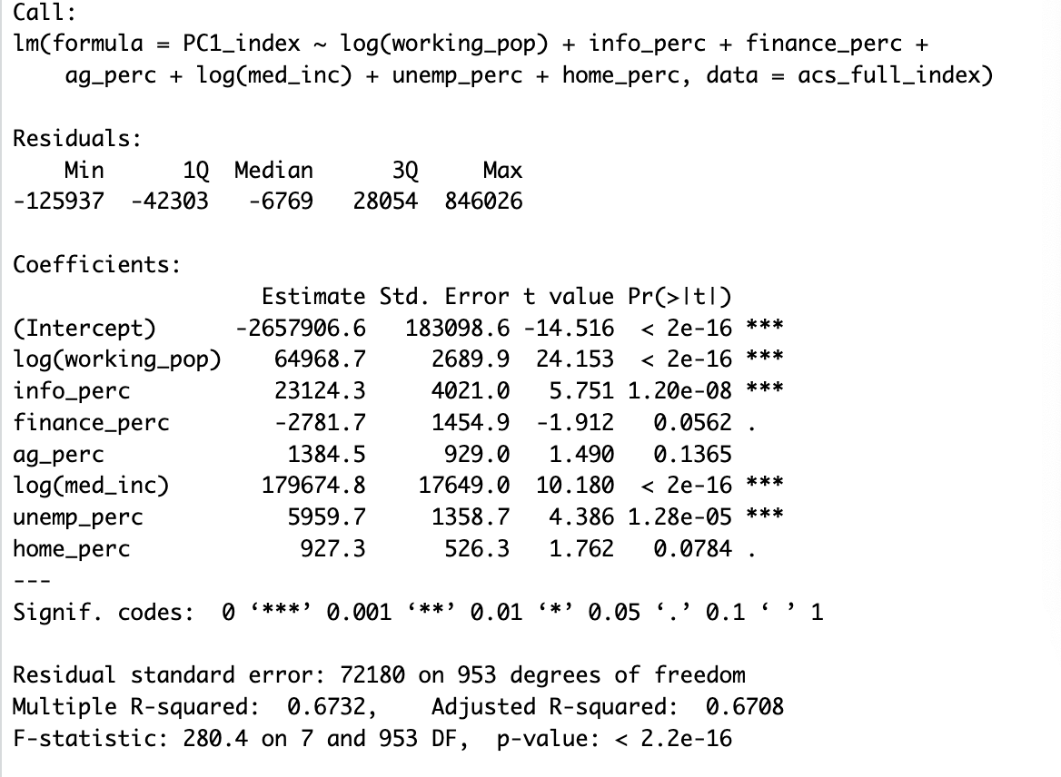
Regression Results
Intro
Recap
Pivot
Analysis
Modeling
(Housing index as the outcome variable)
The outcome is not perfectly satisfactory.
Certain interpretations are reasonable (info_perc, med_inc, and home_perc).
However, others are not (finance_perc and unemp_perc).

Slide 23
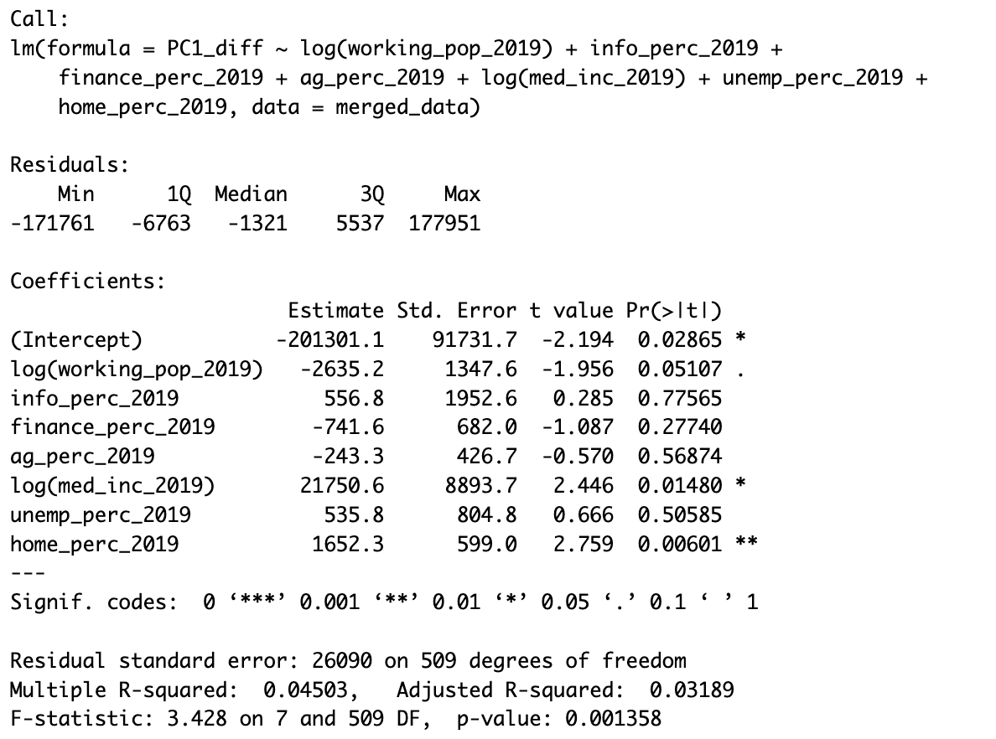
Regression Results
Intro
Recap
Pivot
Analysis
Modeling
(“2021 PC1 - 2019 PC1” as the outcome variable)
Results have improved.
The percentage of people working from home and the median income in 2019 positively contribute to the increase in housing costs during Covid.
The working population in 2019 is negatively correlated with the rise in housing index during the pandemic.
Uncertain about converting to monetary values.
Notes:
If income/WFH % increase by x%, index will increase by y%

Slide 24
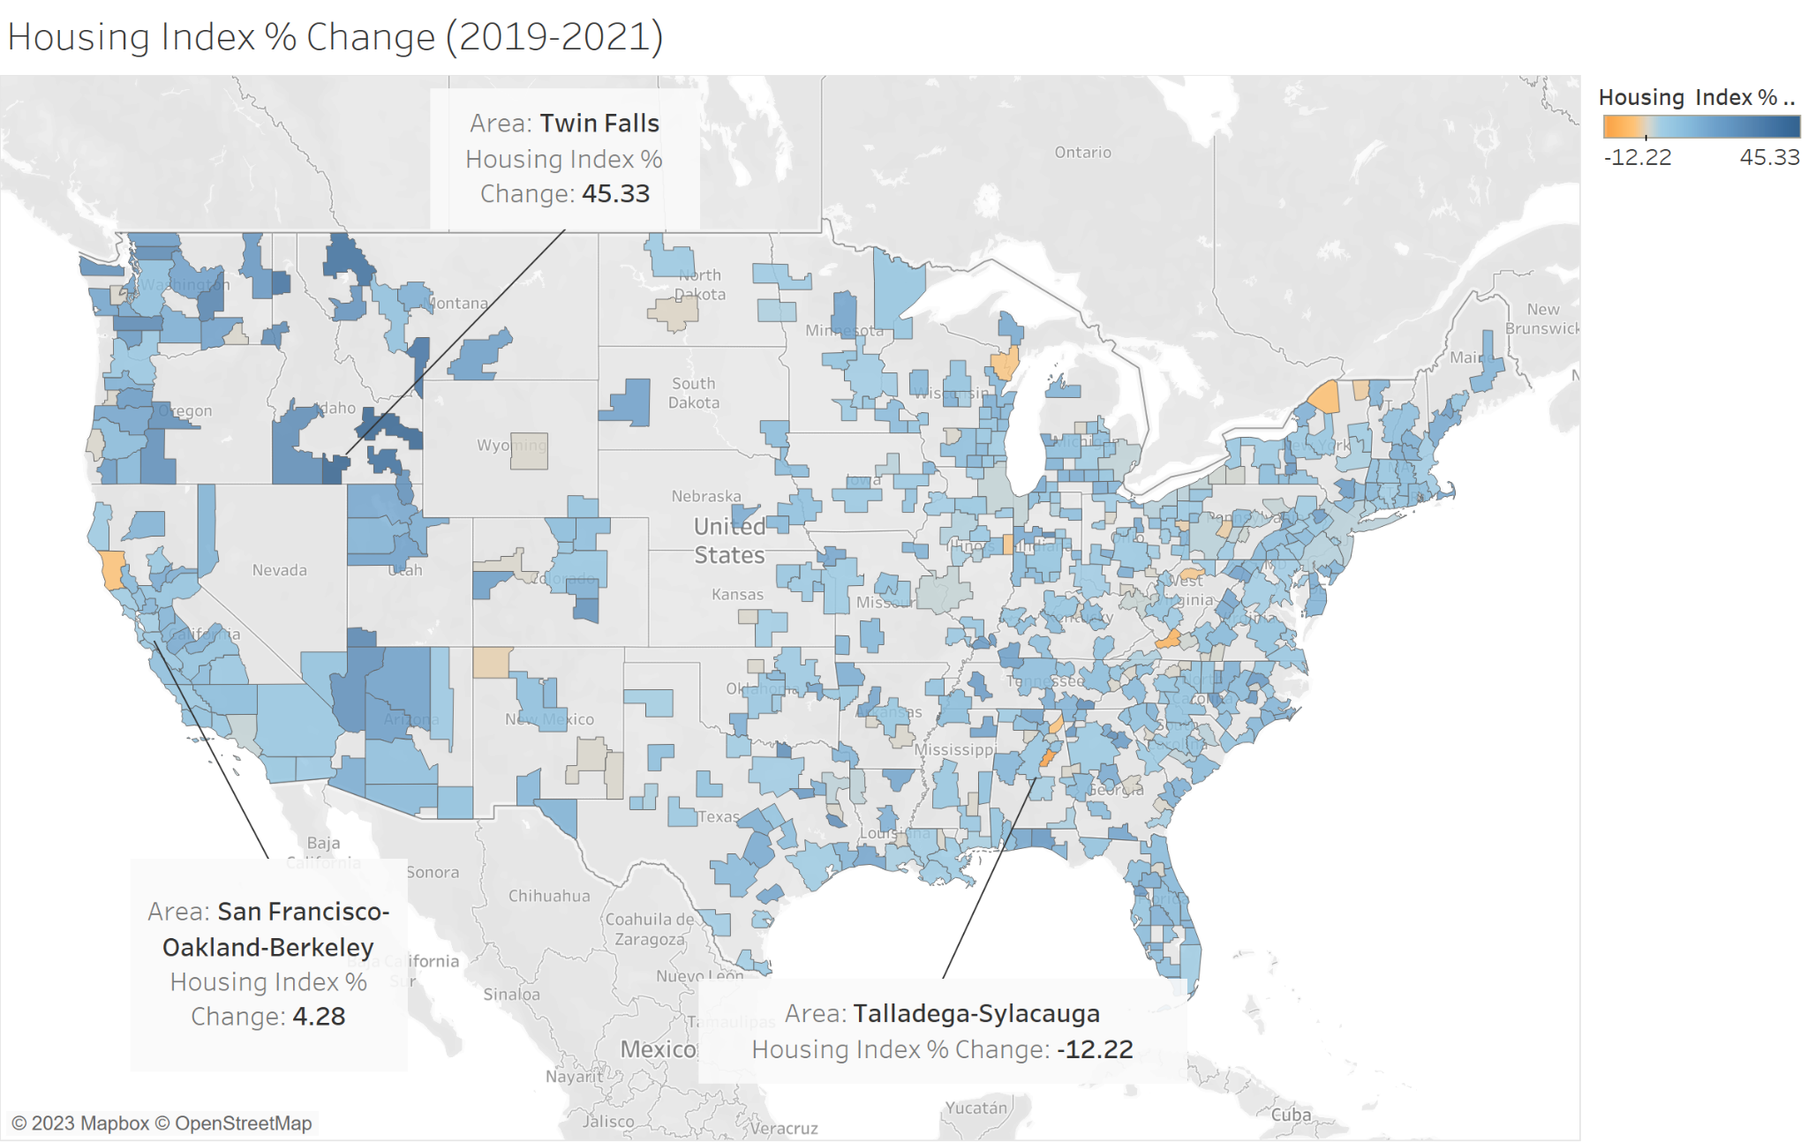
Housing Price Index % Change (2019 vs 2021)
Intro
Recap
Pivot
Analysis
Modeling
Housing prices have experienced significant increases in states such as Idaho, Utah, Arizona, Florida, and others.
Individuals are relocating to areas where the rent was lower prior to the Covid pandemic.
Notes:
List of coefficients

Slide 25

Conclusions
Intro
Recap
Pivot
Analysis
Modeling
In areas where there is a high prior percentage of people working from home and median income, as well as in locations with a lower prior working population, we should investigate housing cost control measures or increasing the housing supply.
Should we encounter a similar pandemic in the future, we recommend implementing rent control measures and constructing extra housing in the MSAs that the model predicts will have the highest housing index increase during the crisis.
Notes:
For example: If MSA’s index increases by some threshold, then rent control should be imposed Big picture Specific example: Would like to set threshold to recommend rent control, but this is not possible due to differences in consumer decision-making, costs of living, and many other factors
If you have a prediction of PCA1 level that is extremely high
Can we add something here that ties directly back to interested parties?

Slide 26

Discussion
Intro
Recap
Pivot
Analysis
Modeling
Limitations
To make a more causal statement, we require data with greater granularity in terms of both time and geographical area.
The results from our housing index do not directly correspond to a monetary value.
Future Work Directions:
Exploration of alternative data sources.
Additional statistical analyses that yield more interpretable outcomes.
Development of a structural model focusing on policymakers' approach to housing cost control and its implications for welfare.
Notes:
Limitations of data set, issue of heterogeneity across MSAs , how this could be made more actionable (lower granularity + much more data (weekly, monthly, etc)
List challenges: Missing 2020 data, no 2022 data, people living in different areas than they work, …

Slide 27

Thank You!
Questions?
Intro
Recap
Pivot
Analysis
Modeling
Attributions: Slidesgo (Theme), Unsplash (Images)

